Slide 1

AB Testing

Slide 2


Which poster should be used to promote the movie?
Poster A
Poster B

Slide 3




Survey
https://forms.gle/UsL7pvEL6X9onmaR7

Slide 4
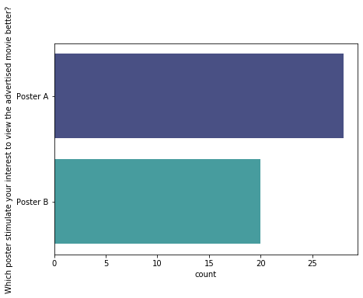


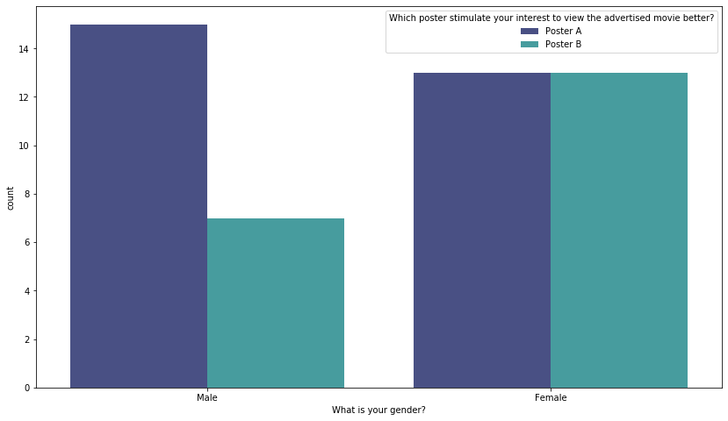
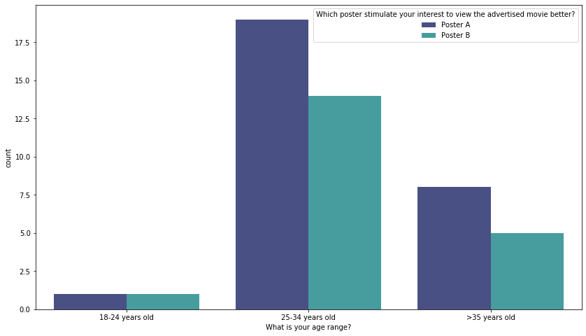
Survey Results
28
(58%)
Number of samples : 48 samples
20
(42%)
15
(31%)
19
(40%)
13
(27%)
13
(27%)
14
(29%)
7
(15%)
8
(17%)
1
(2%)
1
(2%)
5
(10%)

Slide 5
Is poster A preferred over poster B?
H₀ : Proportion of customer preference Poster A : Poster B is 50 : 50 (equal/no preference)
H₁ : Not H₀
df = 2-1 = 1
p_val = 0.2482 (=1-CHISQ.DIST(1.6208, 1, TRUE)
Poster | Observed | Expected | (O-E)²/E
Poster A | 28 | 24 | 0.667
Poster B | 20 | 24 | 0.667
 |  | X² | 1.333
p_val > alpha (0.05) therefore we do NOT reject null hypothesis, thus the proportion of customer preference Poster A and Poster B is 50:50 at 0.05 level of significance.
Action/Inference: There is no difference in poster A and Poster B preference

Slide 6
Does gender affect poster preference?
H₀ : Gender and poster preference are independent
H₁ : Gender and poster and NOT independent
(O-E)²/E
 | Poster A | Poster B
Male | 0.36580087 | 0.51212121
Female | 0.30952381 | 0.43333333
 |  | X² | 1.62077922
OBSERVED
 | Poster A | Poster B
Male | 15 | 7 | 22
Female | 13 | 13 | 26
 | 28 | 20 | 48
df = (2-1) * (2-1) = 1
p_val = 0.20 (=1-CHISQ.DIST(1.6208, 1, TRUE)
EXPECTED
 | Poster A | Poster B
Male | 12.8333333 | 9.16666667 | 22
Female | 15.1666667 | 10.8333333 | 26
 | 28 | 20
p_val > alpha (0.05) therefore we do NOT reject null hypothesis, therefore gender and poster preference are INDEPENDENT at 0.05 level of significance.
Action/Inference: There is no difference in poster preference between males and females

Slide 7
Does age range affect poster preference?
H₀ : Age range and poster preference are independent
H₁ : Age range and poster and NOT independent
OBSERVED
 | Poster A | Poster B
18-34 yrs old | 20 | 15 | 35
>35 yrs old | 8 | 5 | 13
 | 28 | 20 | 48
OBSERVED
 | Poster A | Poster B
18-24 yrs old | 1 | 1 | 2
25-34 yrs old | 19 | 14 | 33
>35 yrs old | 8 | 5 | 13
 | 28 | 20 | 48
EXPECTED
 | Poster A | Poster B
18-34 yrs old | 20.4166667 | 14.5833333 | 35
>35 yrs old | 7.58333333 | 5.41666667 | 13
 | 28 | 20 | 48
EXPECTED
 | Poster A | Poster B
18-24 yrs old | 1.16666667 | 0.83333333 | 2
25-34 yrs old | 19.25 | 13.75 | 33
>35 yrs old | 7.58333333 | 5.41666667 | 13
 | 28 | 20 | 48
(O-E)²/E
 | Poster A | Poster B
18-34 yrs old | 0.0085034 | 0.01190476
>35 yrs old | 0.02289377 | 0.03205128
 |  | X² | 0.07535322
*because one cell contains
E < 5, we must combine

Slide 8
Does age range affect poster preference?
H₀ : Age range and poster preference are independent
H₁ : Age range and poster and NOT independent
df = (2-1) * (2-1) = 1
critical val = 3.84145882 (=CHISQ.INV.RT(0.05, 2))
p_val = 0.78370 (=1-CHISQ.DIST(1.6208, 1, TRUE))
p_val > alpha (0.05) therefore we do NOT reject null hypothesis, therefore age range and poster preference are INDEPENDENT at 0.05 level of significance.
Action/Inference: age ranges --> There is no difference in poster preference between different age range

Slide 9
Conclusion
Either poster A or B can be used to advertised for the movie for all genders and all age ranges

Slide 10



